Slide 2
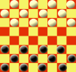
1.2 Checkers - Dame (Board Game)
Objectives
Participants should be taught to count reliably up to 12 items. The game Checkers was chosen, because the board exists of 8 by 8 fields and it is played with 12 men each.
Students understand that all the fields on the board have the same size and the same area.
Students learn all about squares (length, height and right angle).
The students construct different squares and count the fields.
The students learn about square numbers, e.g. “a square, which the length of 3 fields, consist of 9 fields. 3*3=9”
The students learn multiplication with equal factors.

Slide 3
1.2 Checkers - Dame (Board Game)
Tools, Materials and Organisation
Take a checkers-board (8 by 8 fields) for each 3 players.
Each group needs 12 white and 12 black men.
Prepare copies from the worksheet for each student.
Each student must have a pencil and a ruler (for constructing)
The lesson takes about 45 minutes.

Slide 4
1.2 Checkers - Dame (Board Game)
Description of the Lesson
First part of the lesson
Explain the game “Checkers”
Arrange groups with 3 persons.
Each group is sitting on an extra table.
The role of the persons in the group: one person is watching the game and the rules and two are playing.
The participants play several times the game "Checkers". They always have to begin with 12 men in the starting position. The Players have fun and sometimes they win the game. This makes them feeling self-confident.
The participants learn to count up to 12 by putting the men to the board.

Slide 5
1.2 Checkers - Dame (Board Game)
Second part of the lesson
Hand out the worksheets to each person one.
Follow the instruction on the worksheet.
Learn all about squares.
See the different squares on the worksheet and count the fields in the squares.
Make a list of square numbers and learn about multiplication.

Slide 6
1.2 Checkers - Dame (Board Game)
Useful Hints
At the end of the lesson the worksheet is completed.
If the participants cannot read, the teacher has to guide them.
If participants have difficulties to count, you have to train – you need more time or you can split the group.
If participants have difficulties to do multiplication with single digit numbers, show the different squares and count the inside squares.
With the free computer tool GEOGEBRA you can construct geometric figures easily: www.geogebra.org
You can do more area calculations by counting squares!

Slide 7
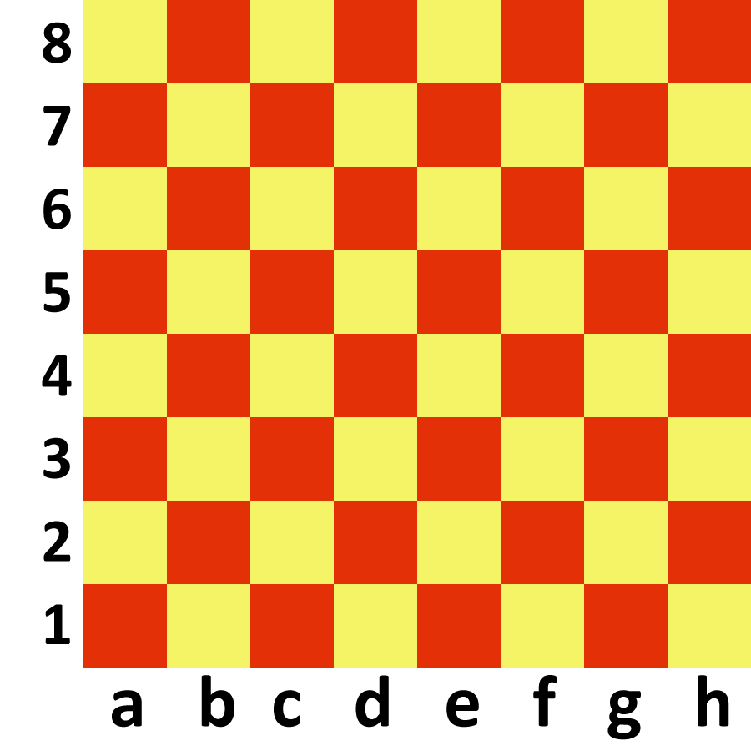

Slide 8
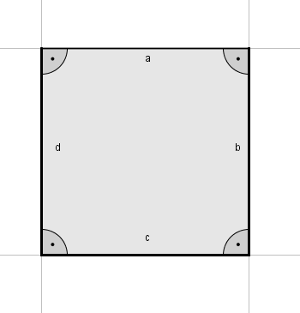
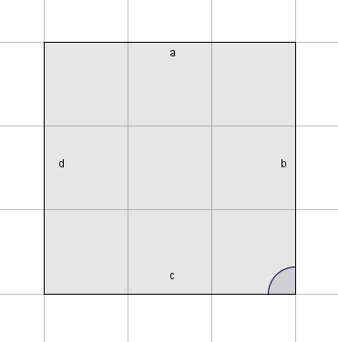
1.2 Checkers - Dame (Board Game)
What is a square?
A square is a geometric figure with the following characteristics:
All side lengths are equal.
All angles are equal; they are right angles.
Construct a square with a side length 3 UL
Count the fields inside this square!
There are 9 fields inside the square with the side length 3.

Slide 9
1.2 Checkers - Dame (Board Game)
Construct 3 different squares with side length from 1 to 9 UL! Use the grid on the left side, talk to other students, so that all possible squares are constructed.
Count the fields inside these squares and note it in a table!
1 | 2 | 3 | 4 | 5 | 6 | 7 | 8 | 9
1
4
9
16
25
36
49
64
81
Definition
The numbers in the second row are called square numbers.

